Slide 1
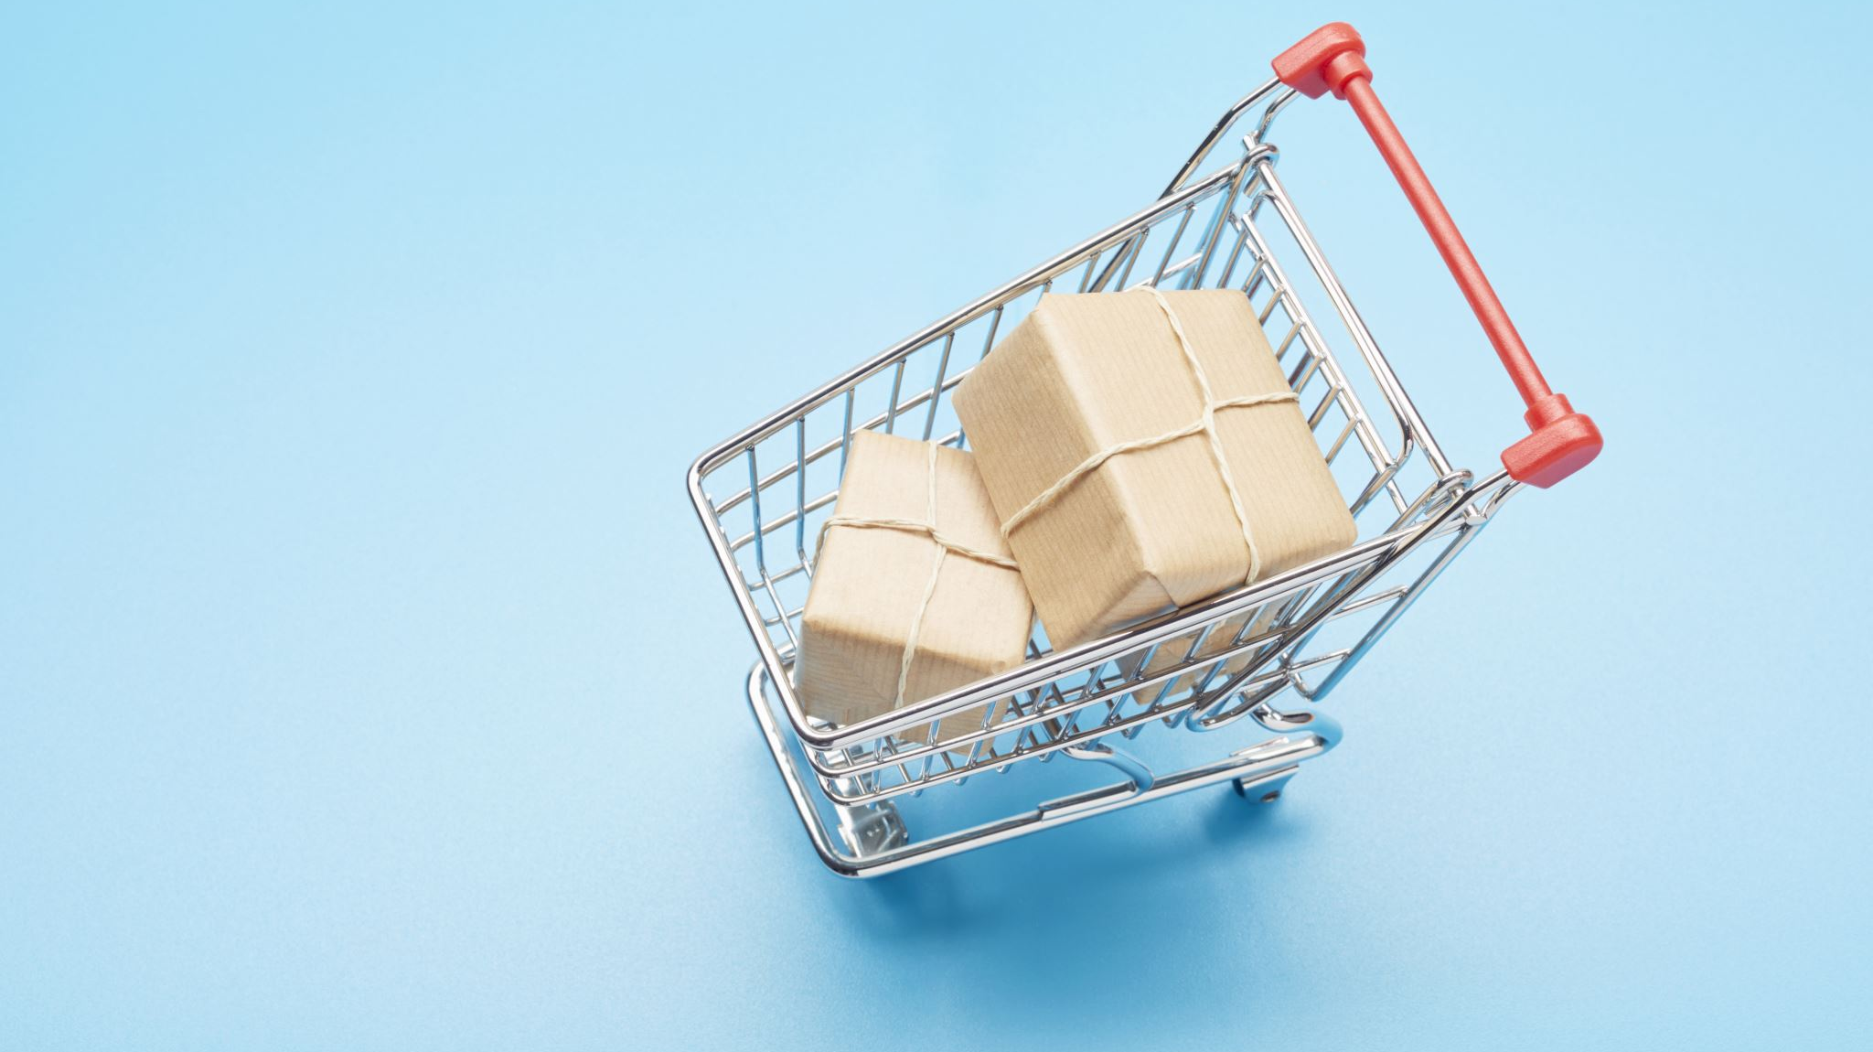
Black Friday Shopper Segmentation Analysis
Group 4
Adithya Enakula
Arpit Ghatoriya
Arshad Shaik
Fayaz Aashiq Shaik
Hema Jiyari
Puja Gundu
Varshitha Pereddy

Slide 2
Agenda
Background and Objectives
Research Methodology
Findings
Segmentation Analysis
Marketing Recommendations
Conclusion

Slide 3
Background and Objectives
Background:
Significance: Black Friday is a major sales event for consumers and retailers.
Challenges:
Varied shopper preferences (online vs. in-store).
Difficulty in crafting universal campaigns.
Objectives:
Profile shopper segments.
Analyze behaviors and preferences.
Recommend targeted strategies.

Slide 4
Research Methodology
Segmentation Variables | Discriminant Variables
Age group | Motivations
Shopping plan | Discount importance
Shopping frequency | Preferred promotions
Shopping preference (online/in-store | Deal discovery sources
Preferred device | Preparation behaviors
Categories shopped most | Purchase influencers (e.g., reviews, price)
Spending amount | Gift-buying likelihood
Survey Details
Sample Size: 60 respondents
Data Collection: Google Forms
Methods
Hierarchical clustering for segmentation
Discriminant analysis for robust segmentation

Slide 5
Segmentation Analysis
Segmentation Approach: Two-segment solution identified as optimal:
Segment 1: Tech-Savvy Bargain Hunters (33%)
Segment 2: Traditional Apparel Shoppers (67%)
Segment 1 Characteristics:
Age: 18–35
Preferences: Online shopping, electronics, high spending (> $500).
Segment 2
Characteristics:
Age: 26–45
Preferences: In-store shopping, apparel, moderate spending ($100–$500).

Slide 6
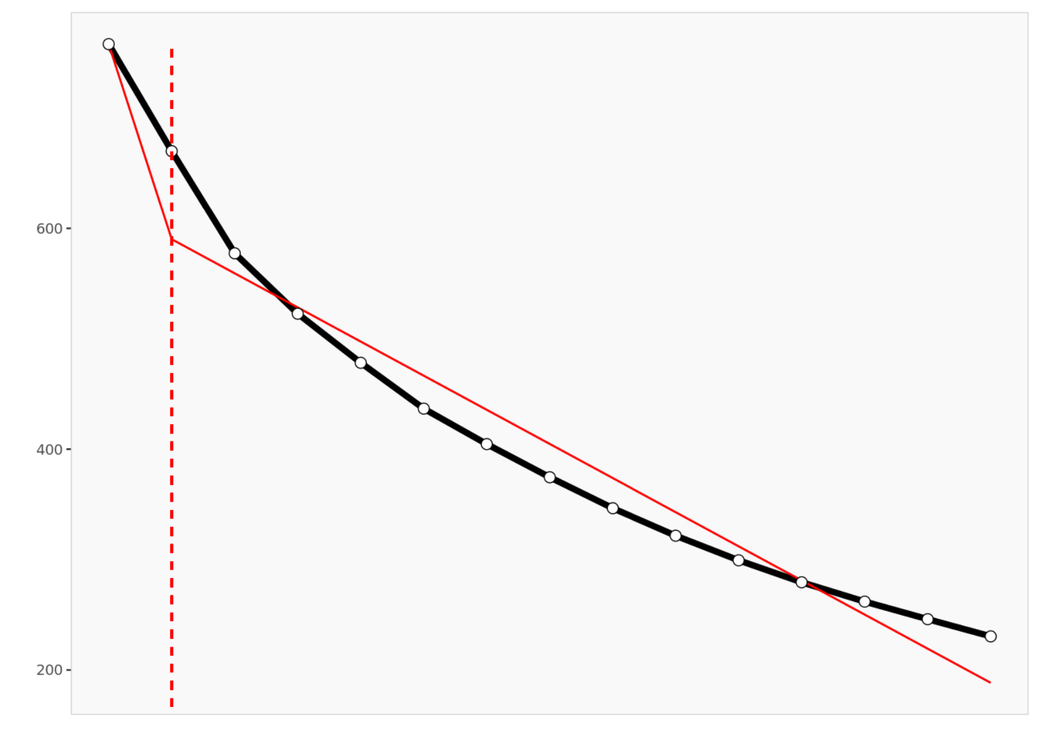
Segmentation Analysis
Optimal Number of Clusters (Scree Plot)
Shows the relationship between the number of clusters and within-cluster variability (SSE).
The "elbow" in the curve indicates the point where adding more clusters has diminishing returns.
Based on the plot, two clusters were selected as the optimal solution.
This ensures a balance between cluster homogeneity and interpretability.

Slide 7
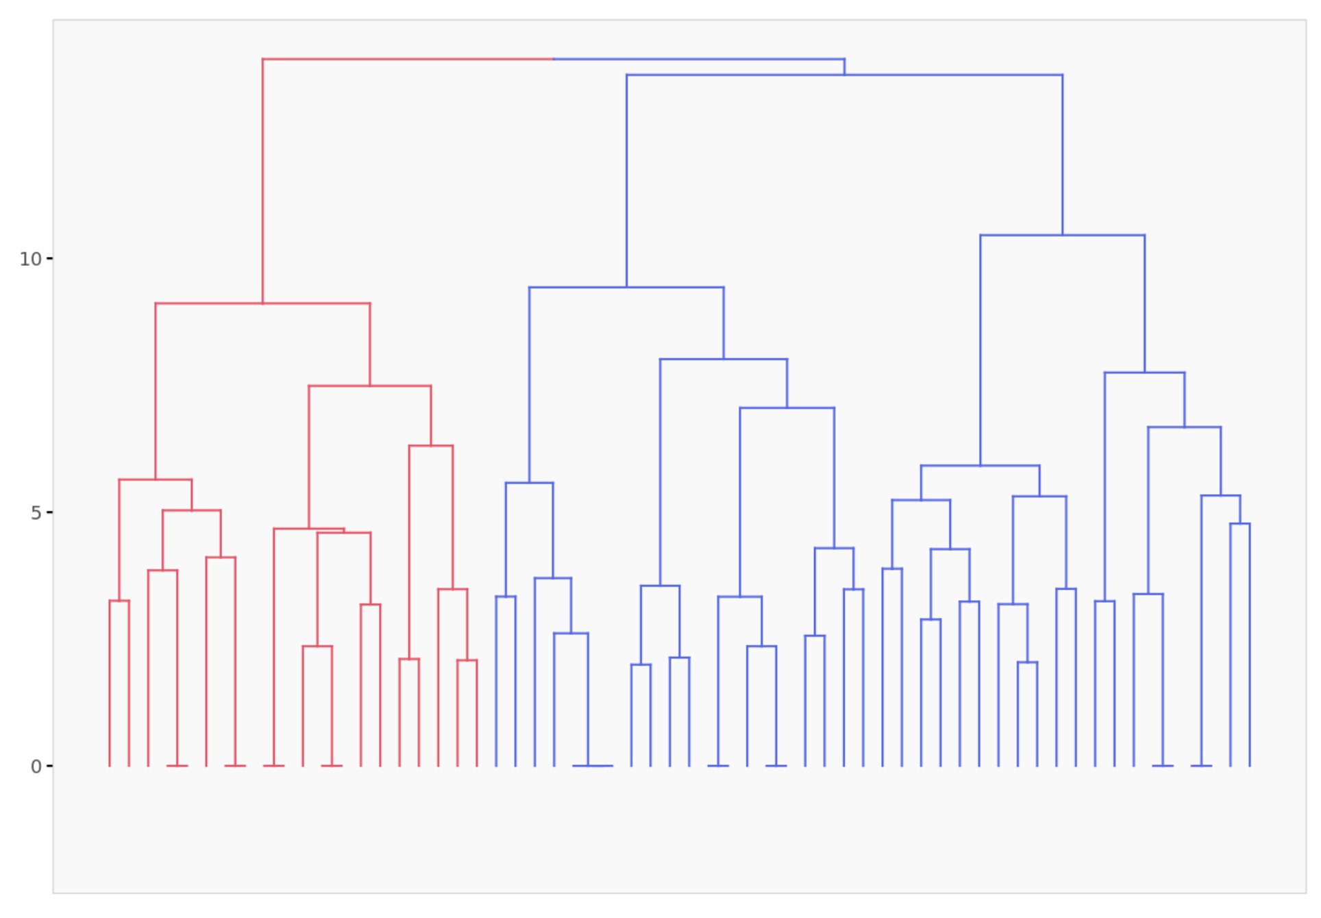
Visuals and Findings
Dendrogram Analysis
Two distinct shopper clusters identified.
Cluster 1: Tech-savvy shoppers (online preference, electronics focus).
Cluster 2: Traditional shoppers (in-store preference, apparel focus).
Provides actionable insights for tailored marketing strategies.

Slide 8
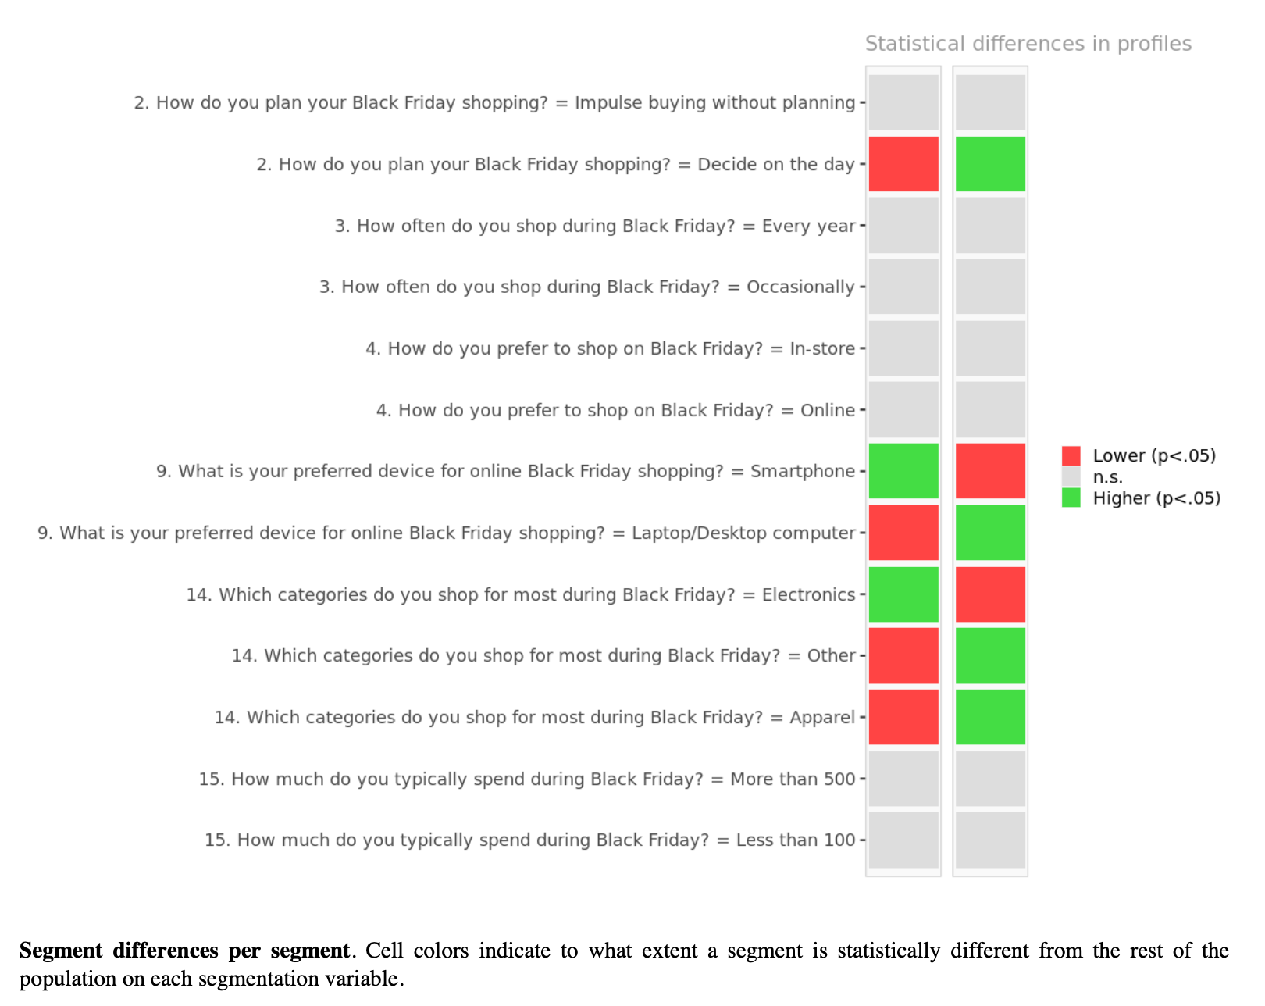
Visuals and Findings
Statistical Differences Between Segments
Highlights key differences across segments:
Red: Lower than average.
Green: Higher than average.
Segment 1:
Prefers electronics and online shopping.
Segment 2:
Focuses on apparel and in-store shopping. Useful for targeted marketing strategies.

Slide 9
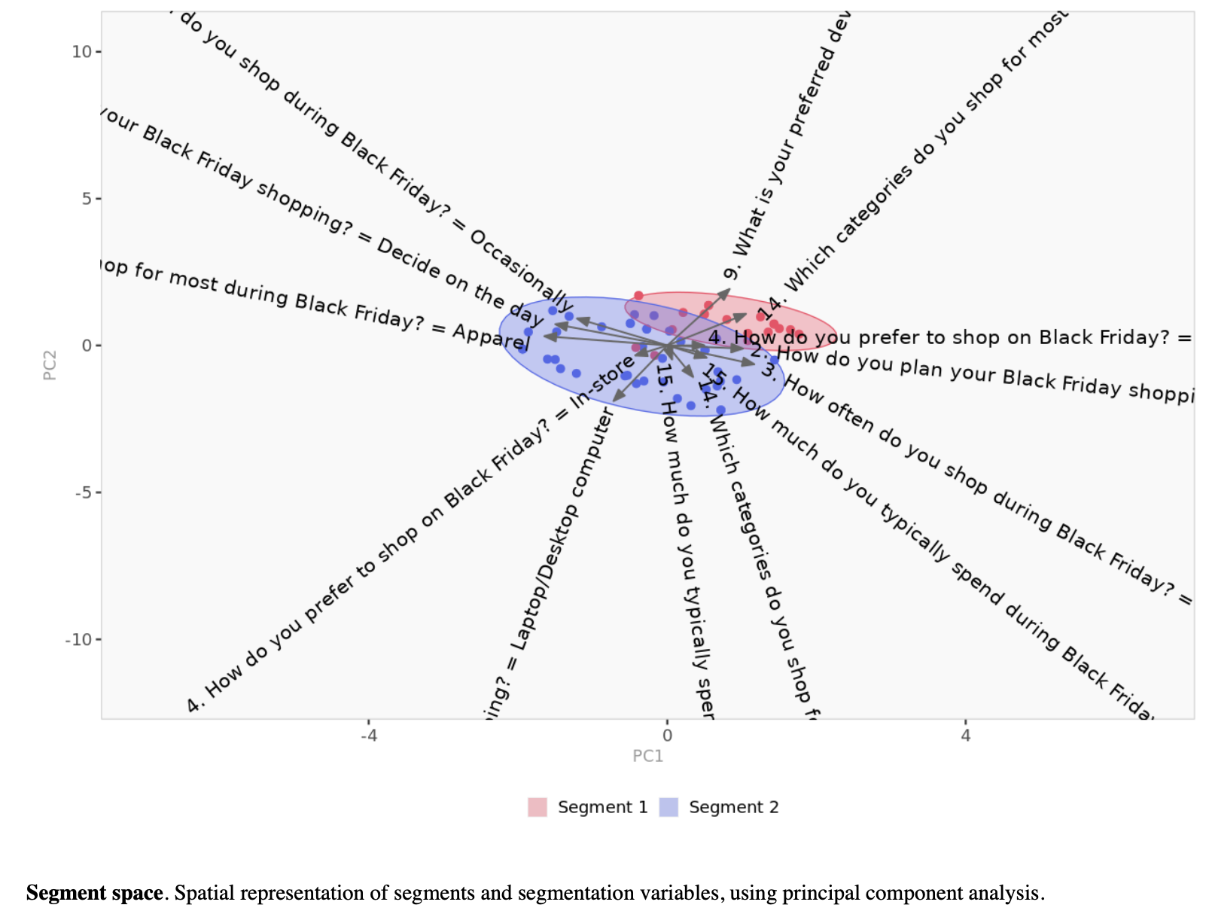
Visuals and Findings
Segment Space
Spatial representation of segments using the first two principal components.
Each point represents a respondent, with segments color-coded for clarity.
Highlights clear separation between segments, validating the clustering process and shopper differences.

Slide 10
Marketing Recommendations
Targeting Strategies: Segment 1: Digital-first campaigns with flash sales and tech deals.
Segment 2: In-store campaigns with personalized promotions.
Promotional Strategies: Flash sales and "buy-one-get-one" deals.
Emphasize discounts and loyalty rewards.
Communication Channels: Social media for Segment 1.
Email campaigns for Segment 2.
Long-term Engagement: Loyalty programs tailored to segment preferences.

Slide 11

Conclusion
Enabled a deeper understanding of diverse shopper behaviors during Black Friday.
Segmentation Value
Shopper preferences vary significantly across channels and product categories, guiding tailored strategies.
Key Insights
Personalized campaigns will enhance engagement and maximize sales.
Actionable Recommendation
Adopt a data-driven approach to continuously optimize marketing effectiveness.
Future Focus

Slide 12

THANK YOU

